Slide 1

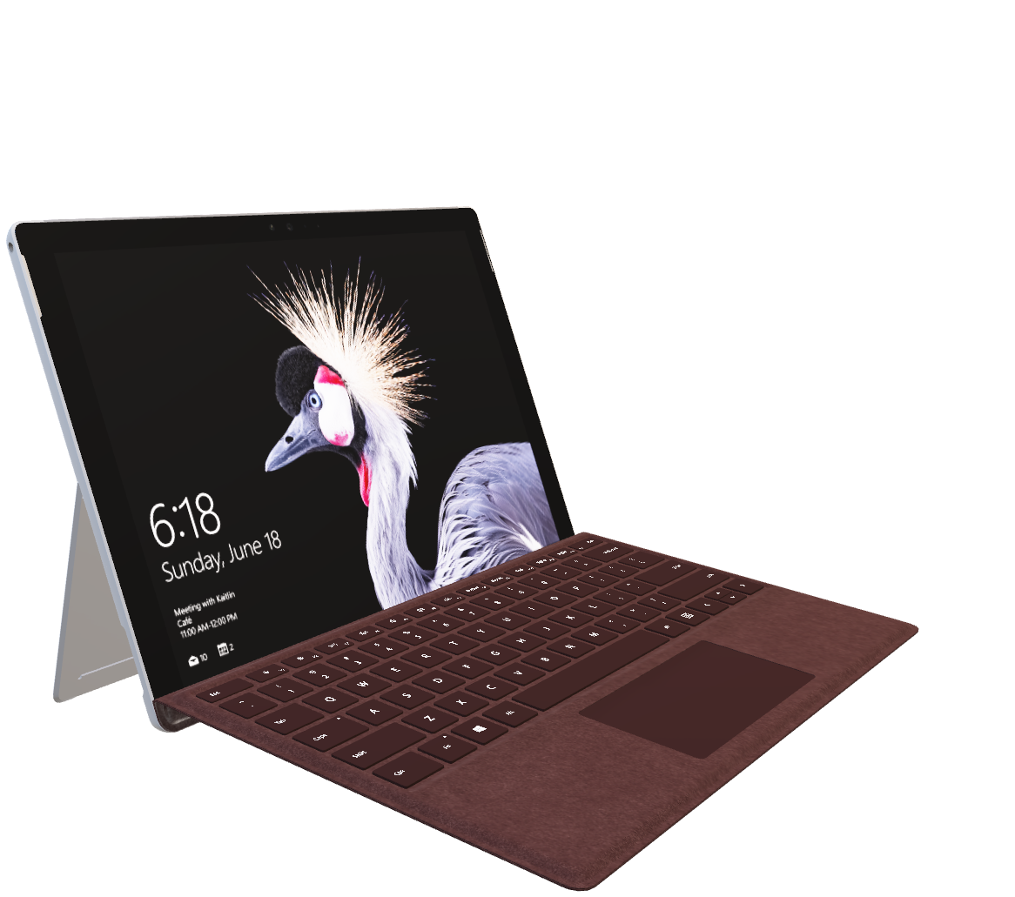
ENTERPRICE APPLICATION DEVELOPMENT
Submitted To: Mr. Lahiru Amalka Yapa
Submited by:
N.Ruvandima MAHDSE221f-014
S.S.Liyanage MAHDSE221f-015
S.D.Samarasinha MAHDSE221f-034
Yasindu MAHDSE221f-035
Geethaka MAHDSE221f-038

Slide 2
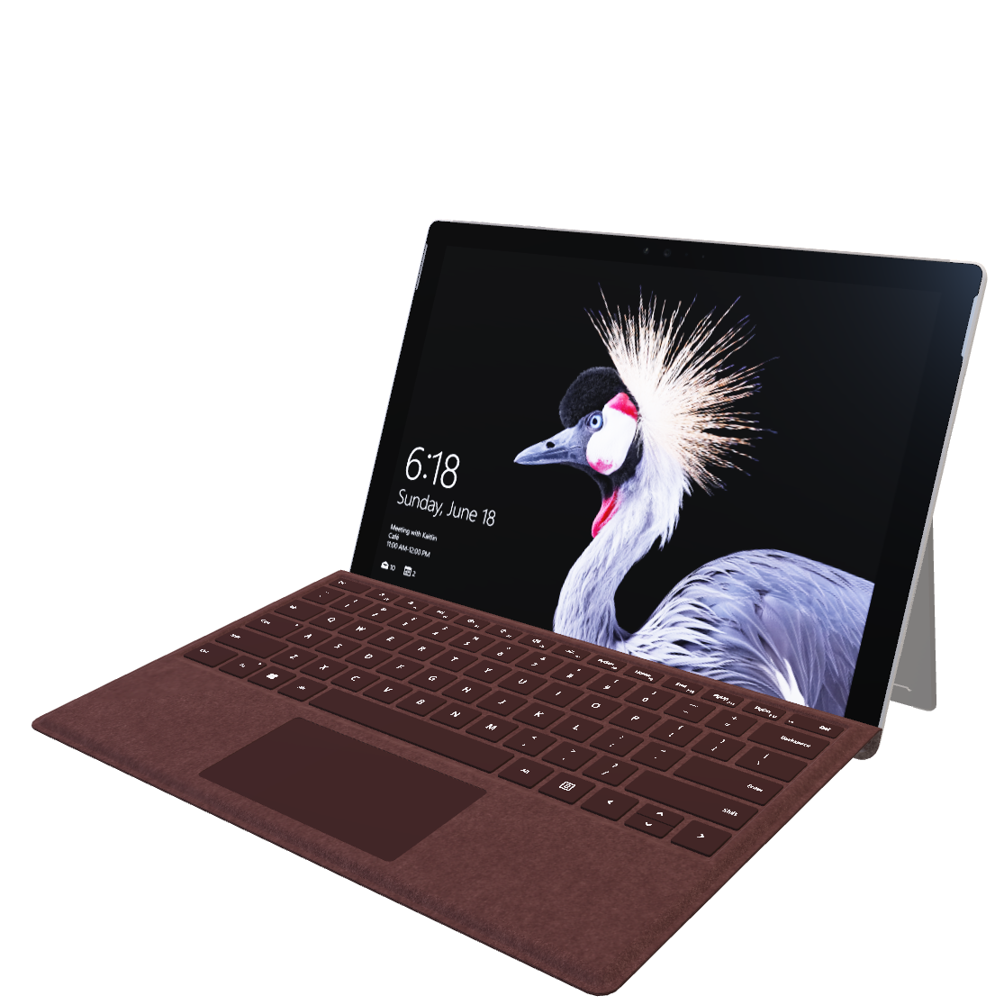
Taxi Ordering service
USER INTERFACE MICROSERVICE
USERS BACKEND MICROSERVICE
ORDERS BACKEND MICROSERVICE

Slide 3
Description of the business scenario

Slide 4
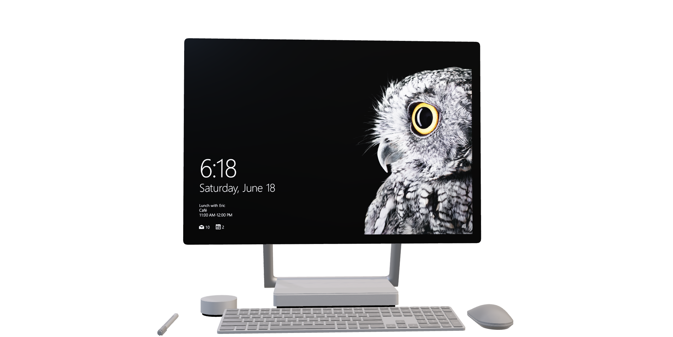
Description of the business scenario
First, any user can register in the register form, by clicking on the register form and clicking the submit button, the function will be called and the entered details will be posted to the user microservices.
When a registered user clicks on the login button, the function is called and the user microservices related to the email and password are called and the email and password are checked. If there is such a user, the user id is returned. The frontend saves the user id and user name in the session register variable
After a registered user logs in, that person can place orders. After filling the order details and clicking on the order button, when logging in, the order details along with the username and user id will go to the order microservices.

Slide 5
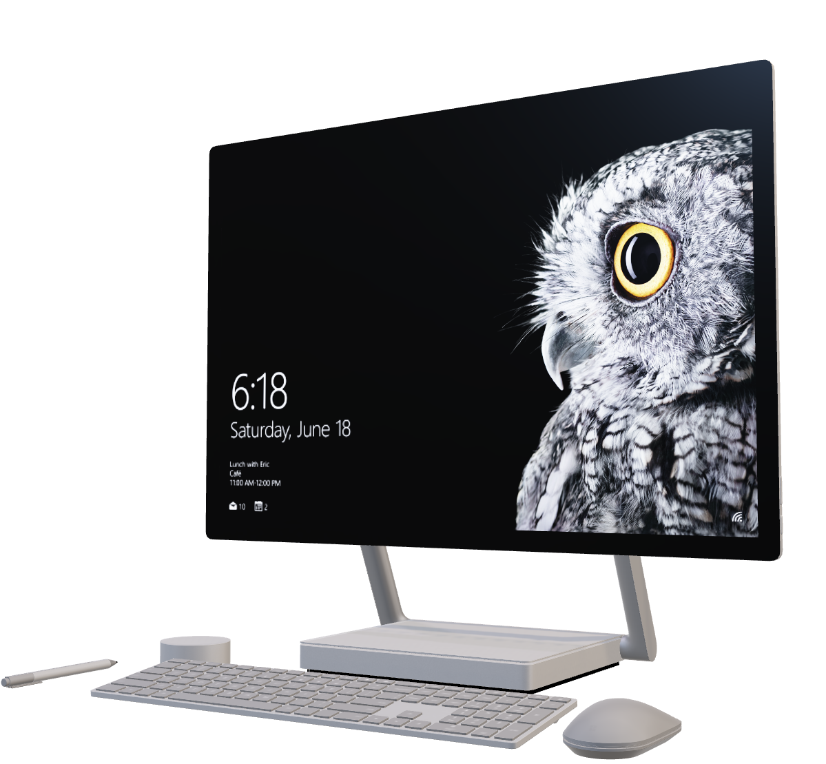
USERS SERVICE
ORDERS SERVICE
ENDPOINTS

Slide 6
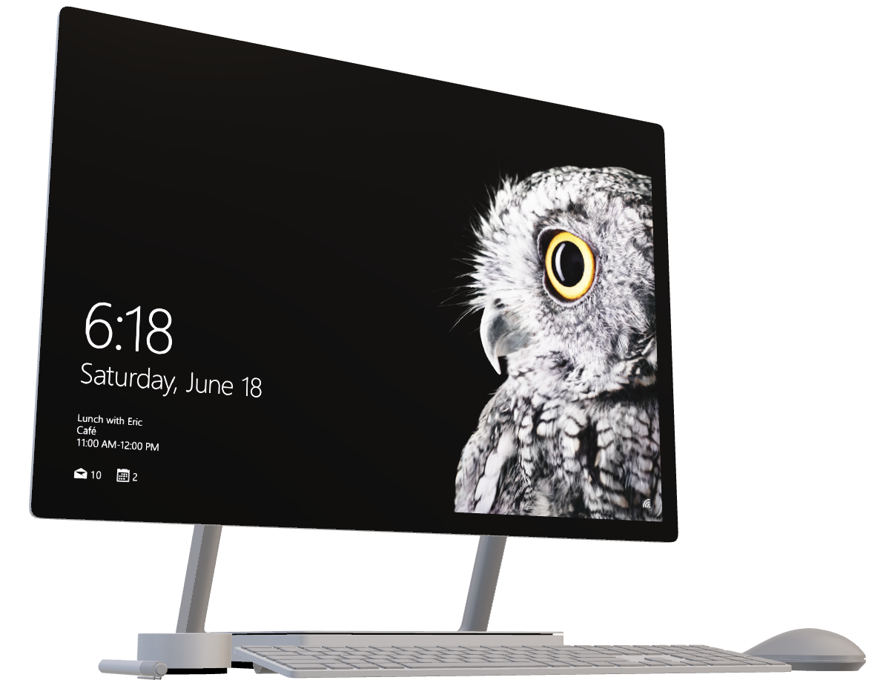
ENDPOINTS
USERS SERVICE
ORDERS SERVICE

Slide 7
USERS SERVICE
ORDERS SERVICE
 | HTTP METHOD | URL | RESULT
User Registration | POST | http://localhost:8081/users | Create new user
User Login | GET | http://localhost:8081/users?email={email} &password={password} | Login existing user
Profile update | PUT | http://localhost:8081/users?userid={id} &username={username} | Update existing user profile
ENDPOINTS

Slide 8
ORDERS SERVICE
USERS SERVICE
ENDPOINTS
 | HTTP METHOD | URL | RESULT
Add Order | POST | http://localhost:8082/orders | Create Order
Order delete | DELETE | http://localhost:8082/orders?iid={id} | Delete order existing order id
Order history | GET | http://localhost:8082/order?userid={id} &username={username} | View all order list by user id and username

Slide 9

USERS SERVICE
ORDERS SERVICE
ENDPOINTS

Slide 10




Laptop
Mobile
UI
UI Micro Service
Orders Micro Service
Users Micro Service
ead_orderservices
ead_userservices

Slide 11
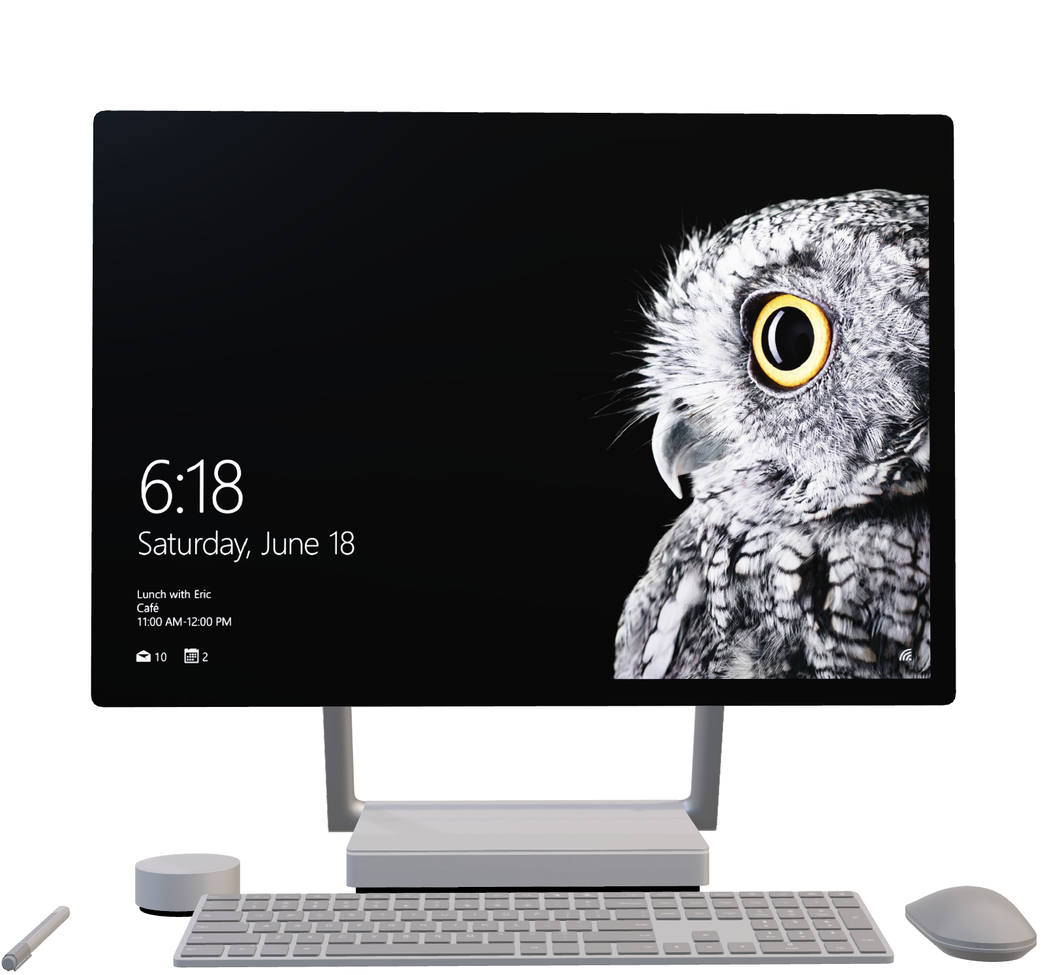
Thank YOU

